Slide 1
Generating JSON/XML from Rhapsody Models (and Instance Specifications)

Slide 2
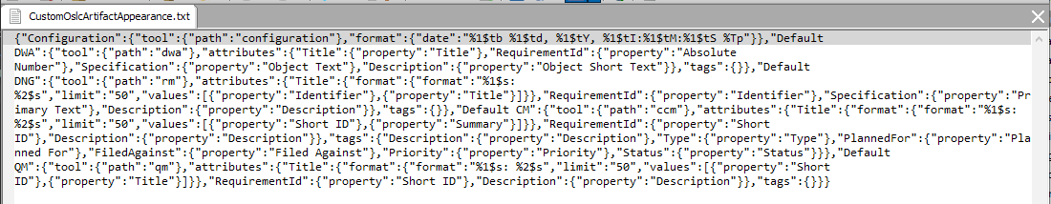
Why would we want to generate JSON ?
JSON is the format that Rhapsody uses to customize how OSLC artifacts appear in the browser, but Rhapsody provides no editor for this:

Slide 3
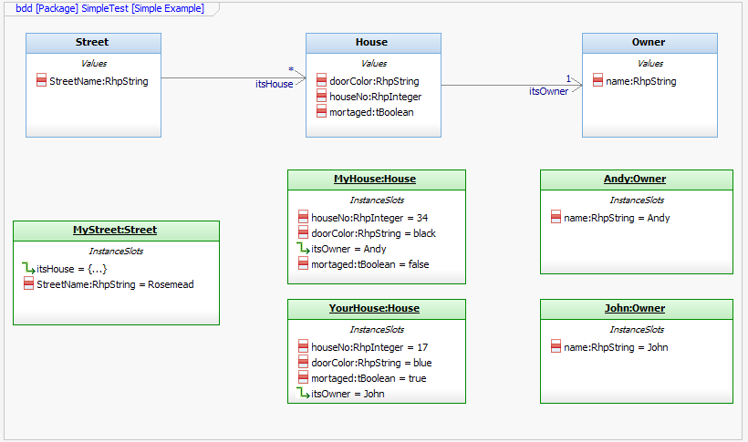
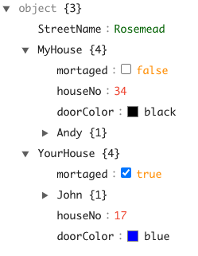
Modeling JSON
We can use instance specifications to model JSON data, allowing multiple instances with different values to be easily represented (Rhapsody Objects are far weaker in this respect from a modeling perspective)
{"StreetName":"Rosemead","MyHouse":{"mortaged":false,"houseNo":34,"doorColor":"black","Andy":{"name":"Andy"}},"YourHouse":{"mortaged":true,"John":{"name":"John"},"houseNo":17,"doorColor":"blue"}}

Slide 4
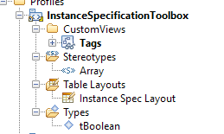
The profile
Included is a profile that pulls in a helper to generate JSON (and XML) as well as some other Instance Specification wizardry

Slide 5
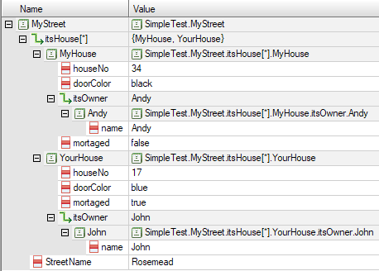
Instance Specs in Table Views
Instance Specs may be represented in Table Views (these may also be exported)

Slide 6
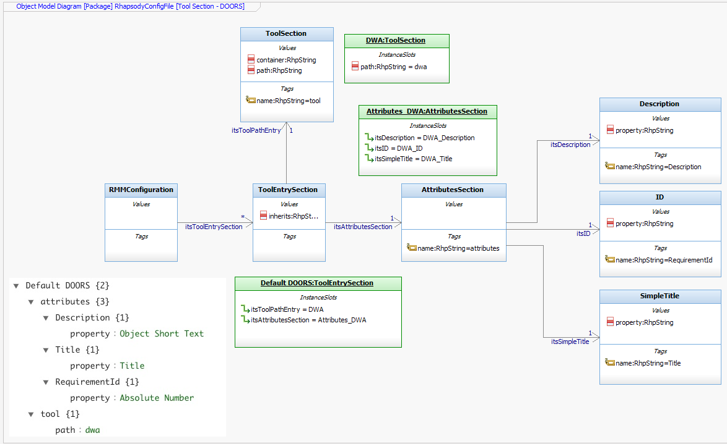
The sample
A sample model is included that generates a Rhapsody OSLC configuration file (which includes an example of a custom config for a specific project area)

Slide 7
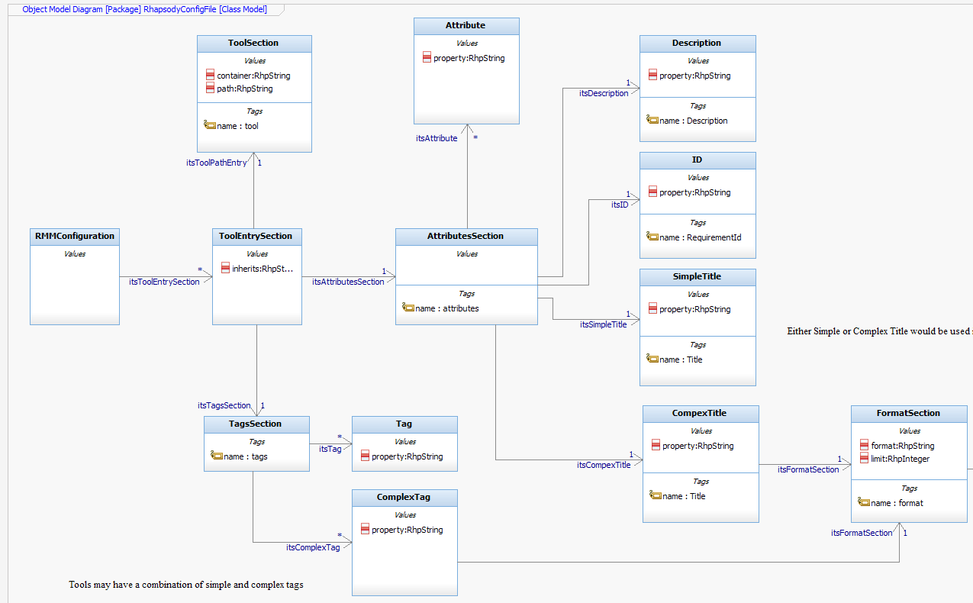
A class model (for generating custom config files)

Slide 8
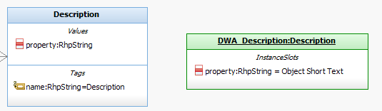
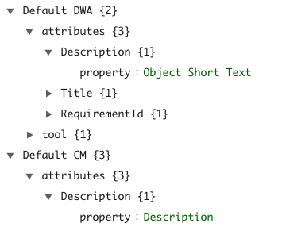
Generating JSON Objects
Each (non array) Instance Specification (IS) becomes a JSON Object. The generation tool checks for the following in order*:
If the IS has a name tag then that name is used
If not then, if the Classifier that the IS is based on has a name tag then that name is used
If none of the above are true then the name of the IS is used
*This is to overcome the Rhapsody restriction that each IS must have a unique name. The JSON file has multiple Description objects (for example) at different levels in the tree – Rhapsody does not allow this

Slide 9
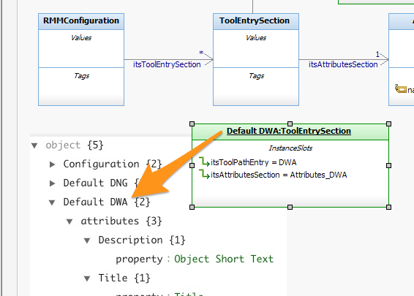
Example 1: Name generated from IS name

Slide 10
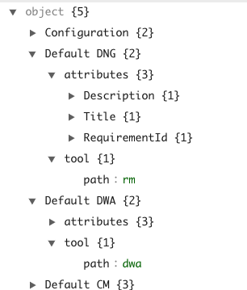
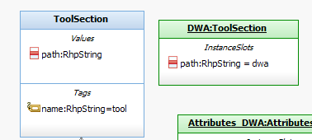
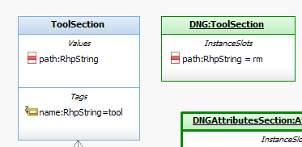
Example 2: Name generated from tag on classifier

Slide 11
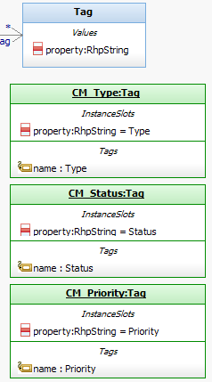
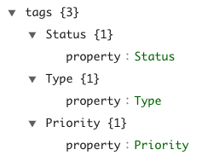
Example 3: Name generated from tag on Instance Spec

Slide 12
Generating JSON attributes
Value properties in Rhapsody become JSON attributes:
RhpString > String
RhpInteger > Integer
tBoolean > Boolean *
RhpReal > Double
*This is a custom enum allowing easy selection of true/false values – Rhapsody’s own RhpBoolean is a simple text field

Slide 13
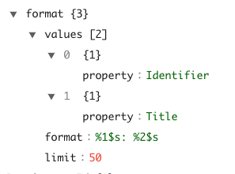
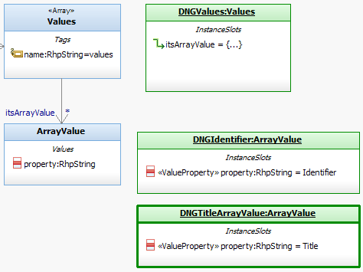
Arrays
By default, nested Instance Specs become nested JSON Objects. To create an Array, apply <<Array>> stereotype:

Slide 14
Creating or Modifying New Config File Entries

Slide 15
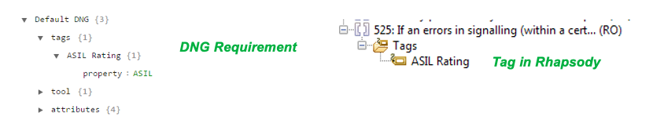
Modifying an entry
Lets, take an example – DNG – and add the capture of some custom attributes. Lets assume you know the property you want to capture is called ASIL, and you want to store that in a tag ASIL Rating

Slide 16
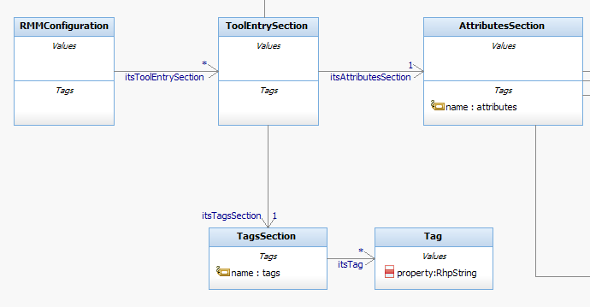
The tags section
The class model has a Tags section
In the sample, DNG has no Instance Spec for the Tags section (CM does if you want to look at an example)

Slide 17
Adding a Tags Section IS
Using Rhapsody
  We cannot simply add a new Instance Spec in the tree where we want it, instead this is a three stage process:
  Create the Instance Spec
  Create a new slot where we want the instance spec to go
  Map the slot to the instance spec created in (1) – Rhapsody will then move it into the correct place in the tree
Using Automation
The Instance Specification Toolkit does (1) and (3) in a single click – see example later

Slide 18


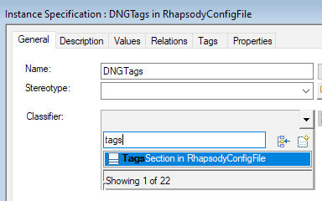
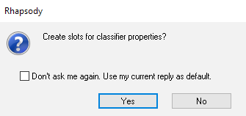
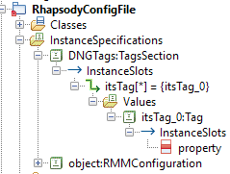
Adding a Tags Section IS - 1
A Tag IS is also created

Slide 19
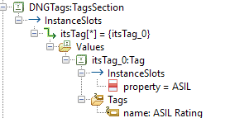
Adding a Tags Section IS – 1.1
The value of the property attribute is the OSLC property we want to capture
The JSON Object name comes from a name tag we manually add

Slide 20
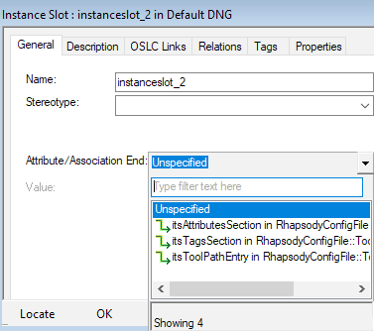
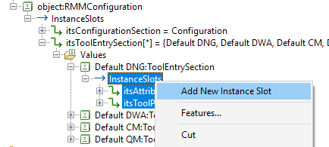

Adding a Tags Section IS – 2

Slide 21
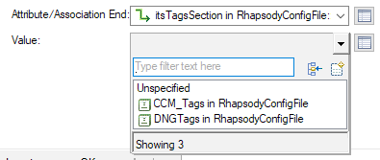
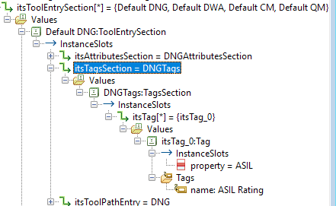
Adding a Tags Section IS – 3
After selecting DNG Tags, Rhapsody moves that node to the tree:

Slide 22
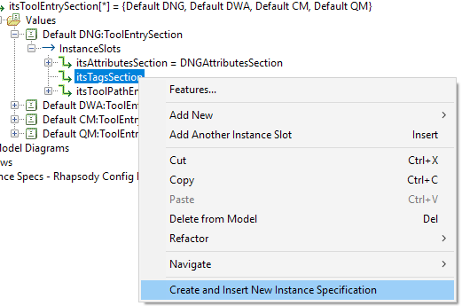
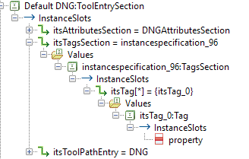
Adding a Tags section using the toolkit
1. Create a Slot
2. Invoke the helper

Slide 23
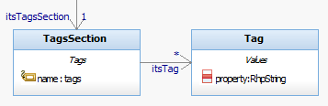
Adding additional tags
We already have a tags section IS
Its associated classifier has an association to ‘tags’ with a multiplicity of *
Our Tags Section IS has one Tag slot already
Adding new slots to multiplicities using Rhapsody is slightly easier*:
Create a slot
Populate the slot
Populate the value(s)
Example on next slides …..
*The automation also works here – you can add new IS in a single click !

Slide 24
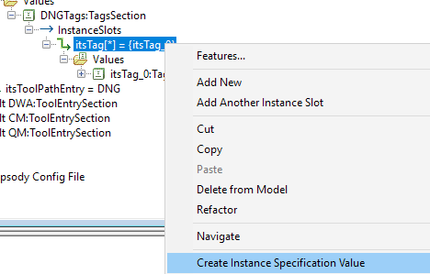
Adding a Tags Section - 1
Add a new Instance Spec to the slot:

Slide 25
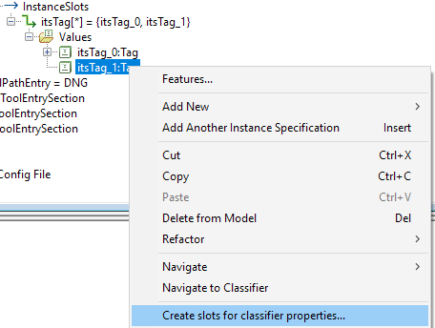
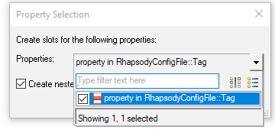
Adding a Tags Section - 2
Populate the new IS with slots:

Slide 26
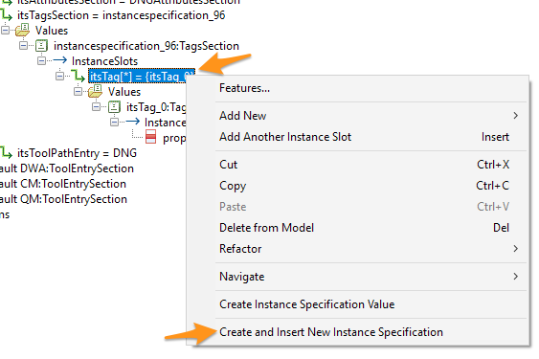
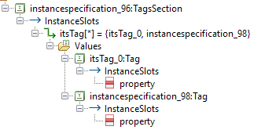
Adding a new IS using automation

Slide 27
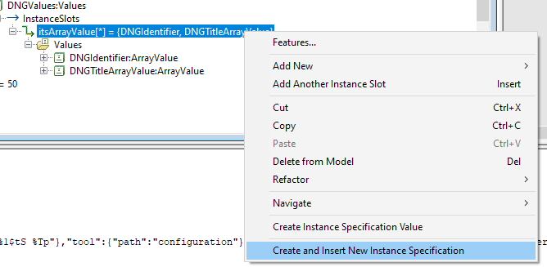
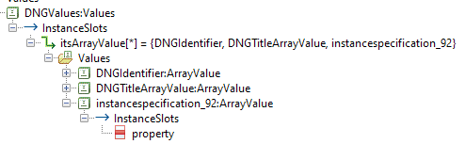
Create and Insert

Slide 28

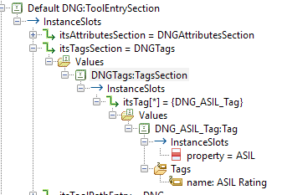
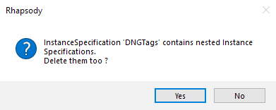
Deleting
Slot deleted, IS moved to package
Deleting a slot will cause that slots contents to move back out of the tree (into the package where the classifier is described)
Deleting the instance specification itself will delete it everywhere (be careful if you’ve used it more than once – it will also delete its children - be very careful about deleting)
Complete deletion of IS and its children, Slot remains and must also be deleted*
*Undo does not work here – be very careful.

Slide 29
Generating XML

Slide 30
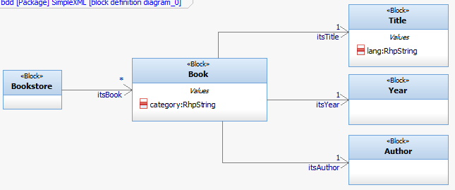
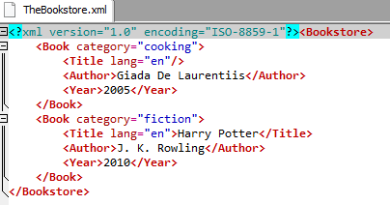
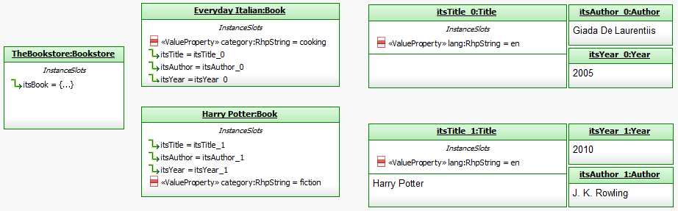
Modeling XML
Modeling XML is a lot like modeling JSON with the following major differences:
Instance Specifications become XML ‘objects’ – the title of which is always taken from the classifier
If the Instance Spec has a description that becomes the text of the object

Slide 31
Notes on Instance Specifications

Slide 32
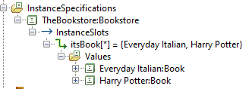
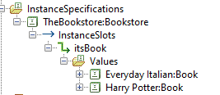
Instance Specification Properties
The displayed text of both instance specifications and slots may be controlled using the properties
Browser:Settings:InstanceSpecificationNameFormat
Browser:Settings:InstanceSpecificationNameFormat
Both are conditional properties and so can be controlled by perspectives

Slide 33
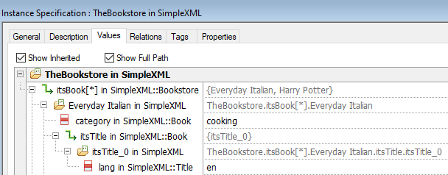
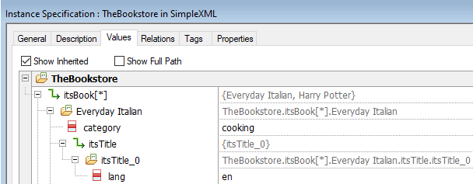
Features view display

Slide 34
Root specifications
Instance Specifications appear in the browser hierarchy where they are used in a slot. The exception to this is ‘root’ instance specs
An instance specification is deemed to be a root when:
It is not referenced by any instance slot
It is referenced by more than one instance slot
It is owned by a package that is different to the package that contains the slot
It is part of a cyclic definition

Slide 35

Unreferenced Instance Specs
If an instance spec is not referenced by any instance slot, then it appears at package level
Referencing an instance specification in an instance slot will cause the instance specification to move automatically to the slot in the tree
Deleting an instance slot will cause any referenced instance spec to then become a root and move automatically to package level

Slide 36
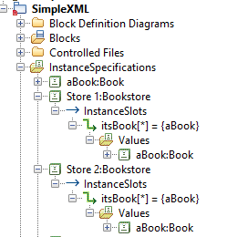
Instance Specs with multiple references
If an instance spec referenced by more than one instance slot, then it appears at package level in addition to every slot that references it (it is the same instance spec so deleting any will delete all)

Slide 37
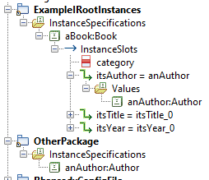
Instance Specs in different Packages
If an instance spec is owned by a package that is different to the package that contains the slot – then it appears twice in the browser (again it is the same instance spec so deleting either will delete both)
Referenced by slot in a different package
Owned by package

Slide 38
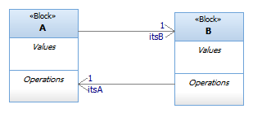
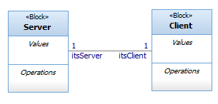




Cyclic definitions
If an instance spec is part of a cyclic definition, then it will appear at package level as well as at slot level (again it is the same instance spec so deleting either will delete both)

